Slide 1
Design and Analysis of Algorithms
National University of Computer and Emerging Sciences, Islamabad

Slide 2
String Matching Algorithms

Slide 3
References
Intro. to Algorithms by Cormen et al
Algorithms on Strings, Trees, and Sequences. Comp. Science & Computational Biology by Dan Gusfield. Section 1.1 & 1.2
Exact String Matching Algorithms.
http://www-igm.univ-mlv.fr/~lecroq/string/index.html

Slide 4
String Matching: Introduction
Finding all occurrences of a pattern in some text
This problem arises frequently in text editing programs.
Efficient algorithms improve responsiveness
In molecular biology, biological molecules can often be approximated as sequences of nucleotides or amino acids.
Search for particular patterns in DNA sequences
Two Types:
Exact String Matching
Approximate String Matching

Slide 5
Exact String Matching Problem
Assume text is any array T[1..n] of length n
pattern is an array P[1..m] of length m≤n
Elements of T & P are characters drawn from a finite alphabet ∑. e.g., ∑ = {0,1} or ∑= {a,b,…,z}.
P & T are strings of characters.

Slide 6
Exact String Matching Problem
P occurs with shift s in T or P occurs beginning at position s+1 in text T if
0 ≤ s ≤ n-m and T[s+1..s+m] = P[1..m]
i.e., T[s+j] = P[j], for 1 ≤ j ≤ m
If P occurs with shift s, s is a valid shift; otherwise we call s an invalid shift.
String matching problem: finding all valid shifts with which a given pattern P occurs in a given text T

Slide 7
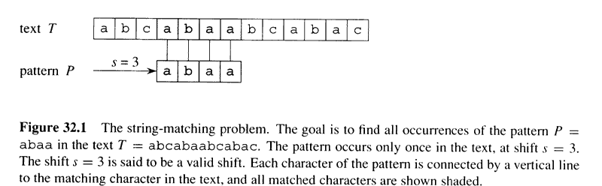
Exact String Matching Problem

Slide 8
Approximate String Matching
Given a text to search (T) and a pattern to look for (P).
Find all of the occurrences of P that exist in T, allowing a defined number of errors to be present in the matches
mispeld
misspelled

Slide 9
Importance
Not a problem for small input
Word Processors, utilities, in library catalog searching programs
Large Input
internet crawlers, digital libraries, e-journals.
Several hundred specialized databases holding raw DNA, RNA and amino acid strings (e.g., US GenBank)
When applied on DNA databases, search may take hours or days.

Slide 10
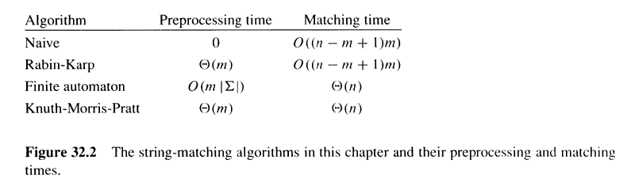
Running Time of String Matching Algorithms

Slide 11
Notation & terminology
∑* = set of all finite-length strings from alphabet ∑
ε = empty string (zero length string)
|x| = length of string x
xy = concatenation of strings x and y, length is |x|+|y|
w is a prefix of x, w╘ x, if x=wy, where y Є ∑*
w is a suffix of x, w ╛x, if x=yw, where y Є ∑*

Slide 12
Notation & terminology (cont’d)
ε is both a suffix and a prefix of every string
ab ╘ abcca
cca ╛abcca
We denote k-character prefix P[1..k] of the pattern P[1..m] by P_{k}.
So P_{o} = ε and P_{m} = P = P[1..m]
Similarly, k-character prefix of text T as T_{k}
String matching prob.: find all shifts in the range
0 ≤ s ≤ n-m such that P ╛T_{s+m}

Slide 13
Overlapping Suffices
x, y and z are strings and x ╛ z and y ╛ z if:
|x|<=|y| then x ╛ y
|x|>=|y| then y ╛ x
|x|=|y| then x = y

Slide 14
Naïve string matching Algo.
Finds all valid shifts using a loop that tests P[1..m] = T[s+1..s+m] for each of n-m+1 values of s
Takes O((n-m+1)m) time.
If m=n/2, it becomes O(n²)

Slide 15
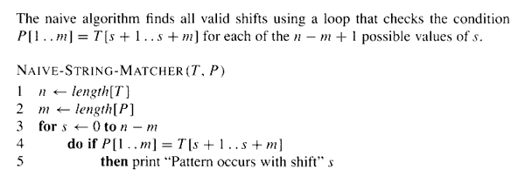
Naïve string matching Algo. (pseudocode)

Slide 16
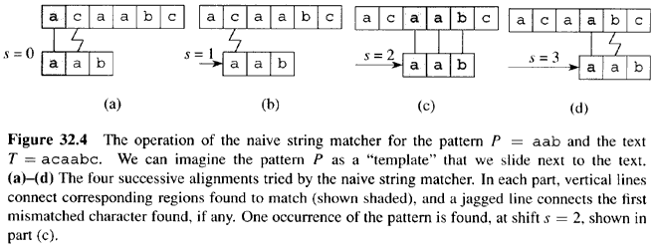
Naïve string matching Algo. (Cont’d)

Slide 17
Why is naïve algo. inefficient?
It tests for each of the n-m+1 possible values of s
The info. gained about text for one value of s is ignored in considering other values of s
e.g., if P=aaab and we find that s=0 is valid, then s=1,2 or 3 are invalid, since T[4]=b

Slide 18
The Rabin-Karp Algorithm
Performs well in practice
generalizes to other algorithms for related problems such as 2D pattern matching
Two steps:
Preprocessing Θ(m)
Matching Θ((n-m+1)m)
Based on certain assumptions, average case running time is better
Makes use of number theoretic notions, equivalence of two numbers modulo a third number

Slide 19
The Rabin-Karp Algorithm (Cont’d)
Assume that ∑ = {0,1,2,…,9}, each character is a decimal digit.
In general, each char. is a digit in radix-d notation, where d=|∑|
A string of k digits = a length-k decimal number
Given pattern P[1..m], let p denote its decimal value
Let t_{s} denote decimal value of length m substring T[s+1..s+m] for s=0,1,…,n-m
t_{s}=p if and only if T[s+1..s+m] = P[1..m]

Slide 20
The Rabin-Karp Algorithm (Cont’d)
Compute p in Θ(m) time
Compute all t_{s} values in Θ((n-m)+1) time
Then, we can determine all valid shifts in time Θ(m) + Θ((n-m)+1) = Θ(n)
Lets not worry that p and t_{s}’s might be very large
It takes lg(a) bits to encode number a
very large=do not fit in a computer word

Slide 21
The Rabin-Karp Algorithm (Cont’d)
We can compute p in Θ(m) time, using Horner’s rule.
p = P[m] + 10(P[m-1] + 10(P[m-2]+…+10(P[2] + 10P[1])…))
e.g., P[1..m]=“3457”, here m=4
p =7+10(5+10(4+10x3))
p =7+10(5+10(4+30)
p =7+10(5+340)
p =7+3450
p =3457

Slide 22
The Rabin-Karp Algorithm (Cont’d)
Similarly compute t_{o} in Θ(m) time from T[1..m]
Use t_{o} to compute each of t₁ ,t₂ ,… , t_{n-m} in constant time, which totals to Θ(n-m) time.
t_{s+1} = 10(t_{s} – 10^{m-1}T[s+1]) + T[s+m+1]
e.g., m=5 and t_{s}=31415 and T[s+5+1]=2, s=0
t_{s+1} = 10(31415 – 10000.3) + 2
= 14152

Slide 23
The Rabin-Karp Algorithm (Cont’d)
If p and t_{s} are very large to work with, mathematical operations on P do not take “constant time”
Simple cure, perform all operations modulo a suitable modulus q
q is chosen, such that dq fits in computer word, where d=|∑| and ∑={0,1,…,d-1}
We might get spurious hits, since t_{s}Ξp (mod q) does not imply that t_{s} = p

Slide 24
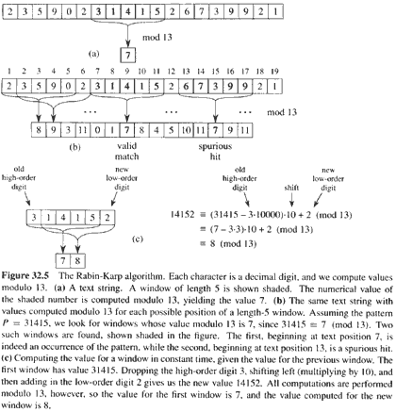

Slide 25
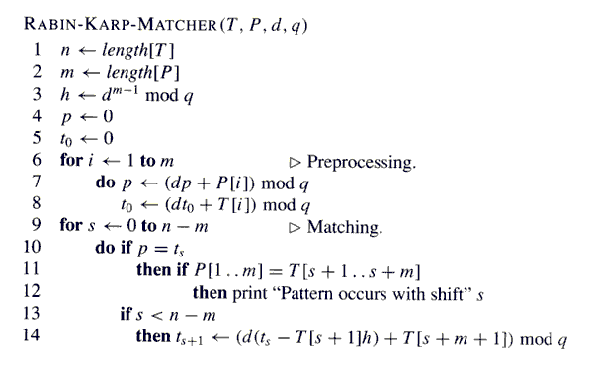

Slide 26
The Rabin-Karp Algorithm (Cont’d)
It takes Θ(m) preprocessing time and Θ((n-m+1)m) matching time in the worst case.
In many applications, we expect few valid shifts (some constant c), then the running time is O((n-m+1) + cm) + time for spurious hits
and if q is large enough (q≥m), we can reduce spurious hits, which gives us O(n+m) running time.

Slide 27
String Matching with finite automata
These algorithms build a finite automaton that scans the text string T for all occurrences of pattern P.
Each text character is examined only once
Time to build the automaton can be large if ∑ is large.

Slide 28
Finite Automata
A finite automaton M is a 5-tuple (Q, q_{o}, A, ∑, δ), where
Q is finite set of states,
q_{o} ∈ Q is the start state,
A ⊆ Q is a distinguished set of accepting states,
∑ is finite input alphabet,
δ is a function from Q x ∑ into Q, called the transition function of M

Slide 29
Finite Automata (Cont’d)
Suppose M is in state q_{o}.
It reads char. a, it moves from state q to state δ(q,a)
Whenever current state q ∈A, the machine M has accepted the string read so far.
An input that is not accepted is said to be rejected

Slide 30
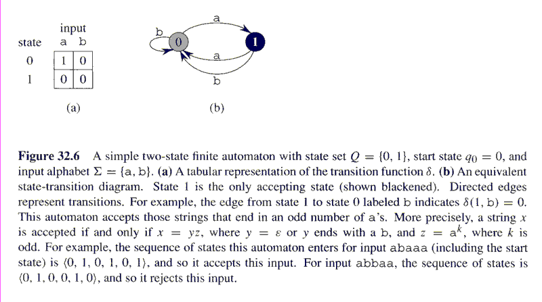

Slide 31
Final-State Function
The automaton M has a final-state function Φ from ∑* to Q, such that:
Φ(w) is the state, M ends up in, after scanning the string w.
M accepts string w if and only if Φ(w) ∈ A.
It is defined recursively as follows:
Φ(w) = q_{o} if w= ε
Φ(wa) = δ(Φ(w), a) for w ∈ ∑*, a ∈∑

Slide 32
String Matching Automata
Every pattern P has finite automaton
It must be built in the preprocessing step
In order to do so, we first define a function called suffix-function σ, corresponding to P
It is a mapping from ∑* to {0,1,…,m} such that:
σ(x) = length of the longest prefix of P that is a suffix of x
σ(x) = max{k : P_{k} ╛x}

Slide 33
String Matching Automata
Suffix function is well defined, since P_{o} = ε is a suffix of every string.
If P=ab, then:
σ(ε) = 0
σ(x) = 0
σ(ccaca) = 1, σ(ccab) = 2

Slide 34
String Matching Automaton corresponding to a given pattern is defined as:
State Set Q = { 0, 1, 2, ….. M}
Transition function
δ(q, a) = σ(P_{q}a)

Slide 35
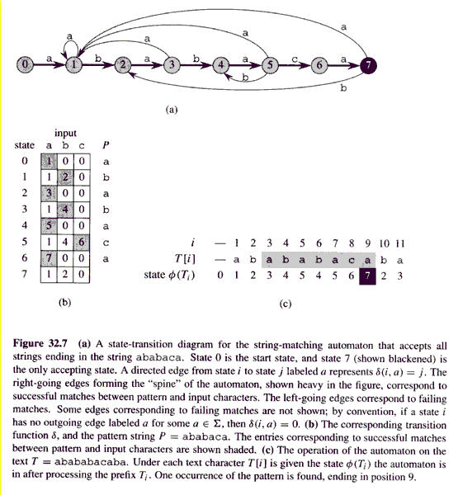
Transition function
δ(q, a) = σ(P_{q}a)

Slide 36
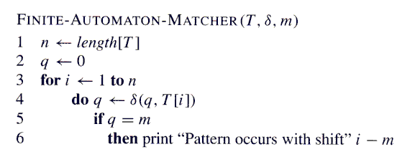

Slide 37
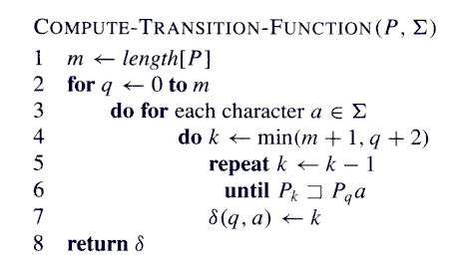

Slide 38
Knuth-Morris-Pratt Algorithm
Runs in linear time.
Avoids the computation of the transition function δ
uses another function π[1..m] pre-computed from the pattern P[1..m] in Θ(m) time

Slide 39
Prefix Function π
The prefix function π for a pattern holds knowledge about how the pattern matches against shifts of itself.
This info. can be used to avoid testing useless shifts that the naïve algorithm does
π contains only m entries, where as δ is a table of m|∑| = md entries

Slide 40
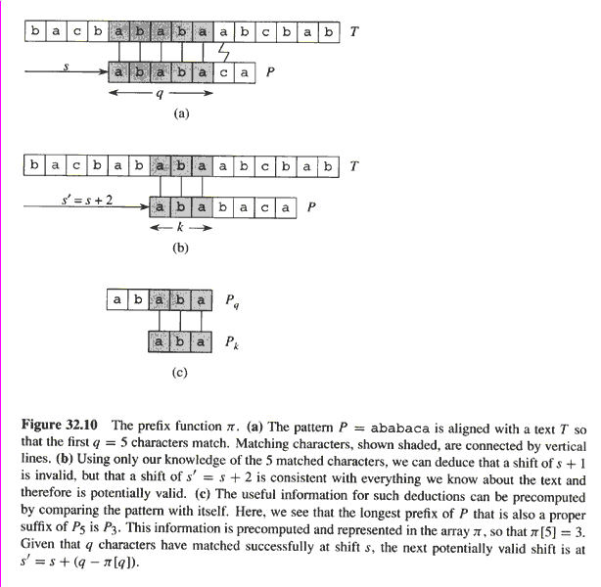
Prefix function
If we precompute prefix function of
P (against itself), then whenever
a mismatch occurs, the prefix function
can determine which shift(s) are invalid
and directly ruled out. So move directly
to the shift which is potentially valid.
However, there is no need to compare
these characters again since they are
equal.

Slide 41
Prefix Function π
If P[1..q] = T[s+1..s+q], what is the least shift s’>s such that:
P[1..k] = T[s’+1..s’+k] where s’+k=s+q ?
Such a shift s’ is not necessarily invalid, due to the knowledge of T[s+1..s+q]
In the best case, s’ = s+q, ruling out s+1, s+2 ,…,s+q-1.

Slide 42
Prefix Function π
This info. can be precomputed by comparing the pattern with itself.
Given P[1..m], π : {1,2,…,m} → {0,1,…m-1} such that :
π[q] = max{ k : k<q and P_{k} ╛ P_{q}}

Slide 43
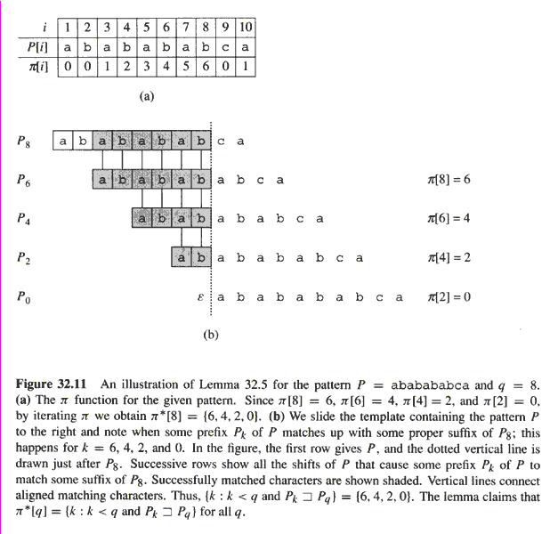

Slide 44
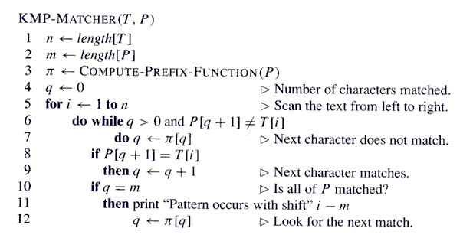

Slide 45
